Slide 1
IOT BASED SMART CROP PROTECTION SYSTEM FOR AGRICULTURE

Slide 2
INTRODUCTION
The Internet of Things Smart technology allows new digital agriculture. Today, technology has become a requirement in order to handle contemporary difficulties, and many industries are utilizing cutting-edge technologies to automate their processes.
Advanced agriculture, based on Internet of Things technology, is intended to help producers and farmers decrease waste and increase output by optimizing fertilizer use to raise plant efficiency. It allows farmers more control over their animals, crops, and costs and resources.
The widespread use of the Internet of Things (IoT), linked devices have permeated every part of our lives, from health and fitness to home automation, automotive and logistics, smart cities, and industrial IoT.

Slide 3
PURPOSE
The project aims at making use of evolving technology i.e. IOT and smart agriculture using automation.
Monitoring environmental conditions is the major factor to improve yield of the efficient crops.

Slide 4
PROBLEM STATEMENT DEFINITION
Proposes the automatic irrigation system using Arduino for smart crop field productivity. This system consists of sensor like moisture sensor, temperature sensor, rain sensor and ultrasonic sensor. Moisture sensor used for detecting the moisture content in soil, temperature sensor is used to measure the temperature value and ultrasonic sensor is used to measure the water level.
If the excess of water in field is detected, then motor will ON to remove it. The measured parameters are uploaded to IOT through this farmer can monitor anywhere. Based on the command from IOT water motor will ON. The measured parameters are displays on LCD.

Slide 5
EXISTING PROBLEM
IoT based smart agriculture monitoring system. Rajalakshmi.P and S. Devi Mahalakshmi, “IOT Based Crop Field Monitoring and Irrigation Automation”, 10th International conference on Intelligent systems and control (ISCO), 2016.
An IOT Based Crop-field monitoring an irrigation automation system describes how to monitor a crop field. A system is developed by using sensors and according to the decision from a server based on sensed data, the irrigation system is automated.
Through wireless transmission the sensed data is forwarded to web server database. If the irrigation is automated then the moisture and temperature fields are decreased below the potential range.

Slide 6
LIMITATIONS
1There could be a wrong analysis of weather conditions.
Devices are to be altered according to the farmers, it will involve equipment which will be expensive.
If there are faulty data processing equipment or sensors, then it will lead to a situation where the decisions are taken wrong .

Slide 7
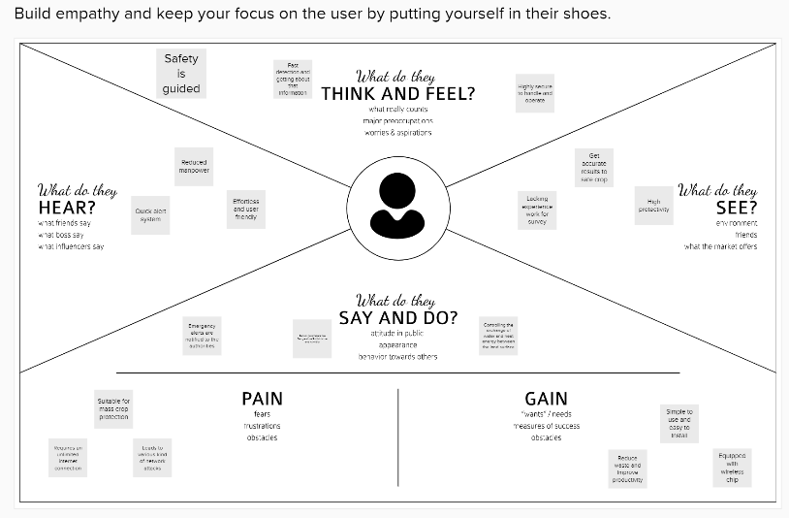
EMPATHY MAP CANVAS

Slide 8
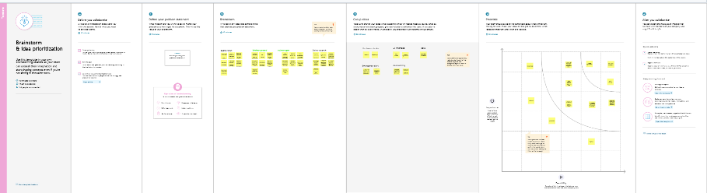
IDEATION & BRAINSTORMING

Slide 9
PROPOSED SOLUTION
S.NO | PARAMETER | DESCRIPTION
1. | Problem Statement (Problem to be solved) | Protecting the crops from wild animals and also monitor the soil moisture levels in the field.
2. | Idea / Solution description | Monitoring the crops using IOT based technology by 24x7.Detecting animals and scared them away. The motors and sprinklers in the field can be controlled using the mobile application.
3. | Novelty / Uniqueness | Accessibility due to the alarm system, being helpful to farmers. Scalability.
4. | Social Impact / Customer Satisfaction | User friendly. Its increase rate of good yield of crops.
5. | Business Model (Revenue Model) | Cost efficient. It’s reduce the anxiety and fear of losing crops meanwhile it’s help to increase the profit comparing to previous year.
6. | Scalability of the Solution | In future it can be enhanced by sending message directly to the fire department in case there is a mass wild animals attacks the fields. The controlling and monitoring of the soil moisture level can be automated by taking care of the crops in case of low moisture level, without notifying the farmers.

Slide 10
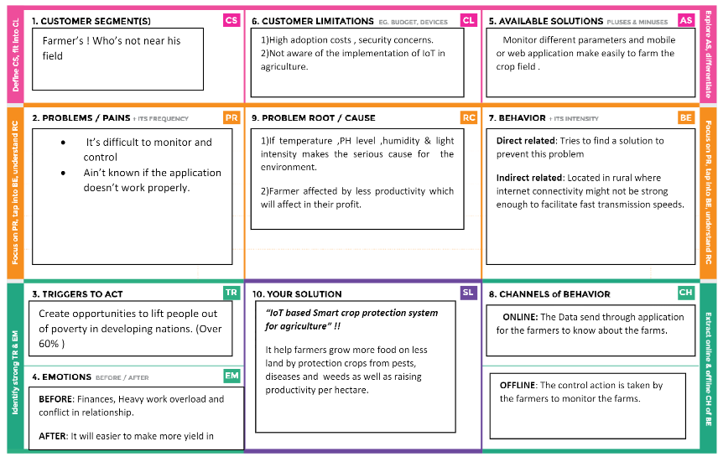
PROBLEM SOLUTION FIT

Slide 11
FUNCTIONAL REQUIREMENT
S.NO | FUNCTIONAL REQUIREMENT | SUB REQUIREMENT.
1. | User Visibility | Sense animals nearing the crop field & sounds alarm to woo them away as well as sends SMS to farmer using cloud service.
2. | User Reception | The Data like values of Temperature, Humidity, Soil moisture Sensors are received via SMS.
3. | User Understanding | Based on the sensor data value to get the information about the present of farming land.
4. | User Action | The User needs take action like destruction of crop residues, deep plowing, crop rotation, fertilizers, strip cropping, scheduled planting operations.

Slide 12
NON-FUNCTIONAL REQUIREMENTS
S.NO | NON-FUNCTIONAL REQUIREMENT | DESCRIPTION.
1. | Usability | Mobile Support Users must be able to interact in the same roles & tasks on computers & mobile devices where practical, given mobile Capabilities.
2. | Security | Data requires secure access to must register and communicate securely on devices and authorized users of the system who exchange Information must be able to do.
3. | Reliability | It has a capacity to recognize the disturbance near the field and doesn’t give a false Caution signal.
4. | Performance | Must provide acceptable response times to users regardless of the volume of data that is stored and the analytics that occurs in background. Bidirectional, near real-time communications must be supported. This requirement is related to the requirement to support industrial and Device protocols at the edge.
5. | Availability | IOT Solutions and domains demand highly available systems for 24 x 7 operations. Isn’t a critical production application, which means that operations or production don’t go down if the IOT solution is down.
6. | Scalability | System must handle expanding load & data retention needs that are based on the up scaling of the solution scope, such as extra Manufacturing facilities and extra buildings.

Slide 13
DATA FLOW DIAGRAMS
A data-flow diagram is a way of representing a flow of data through a process or a system. The DFD also provides information about the outputs and inputs of each entity and the process itself. A data-flow diagram has no control flow — there are no decision rules and no loops. Specific operations based on the data can be represented by a flowchart.

Slide 14
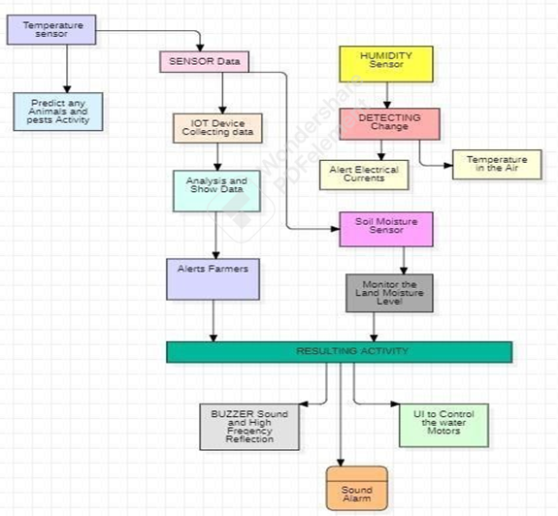
DATA FLOW DIAGRAMS

Slide 15
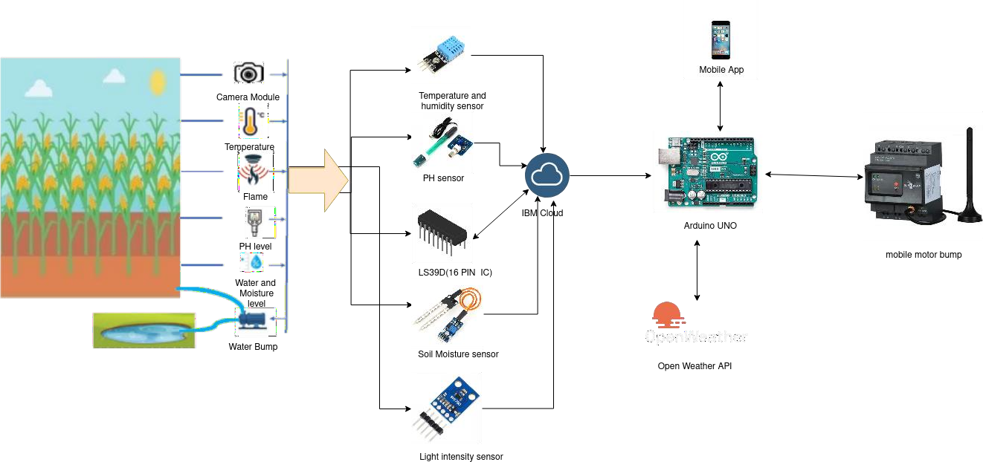
SOLUTION ARCHITECTURE

Slide 16
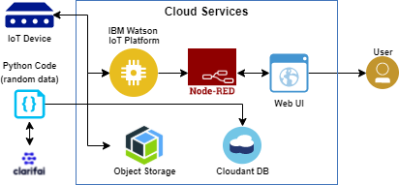
TECHNICAL ARCHITECTURE

Slide 17
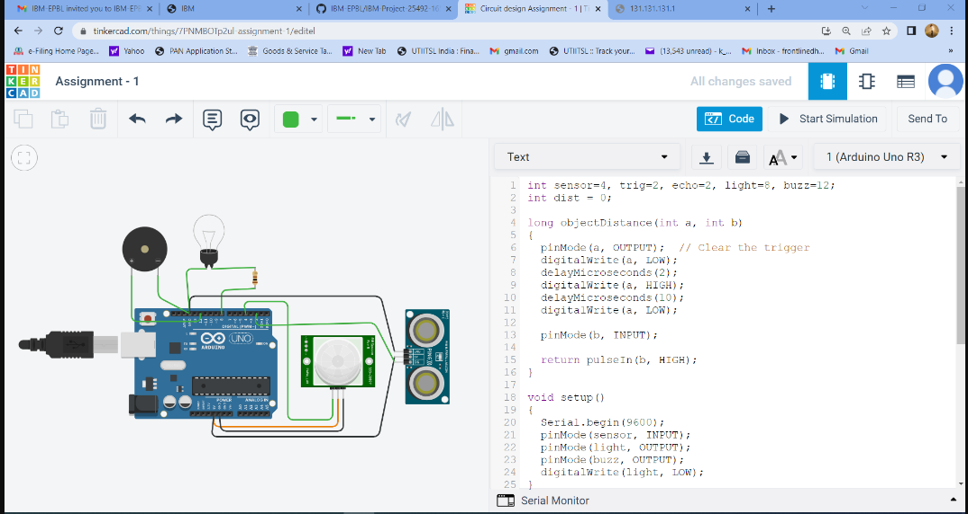
RESULTS

Slide 18
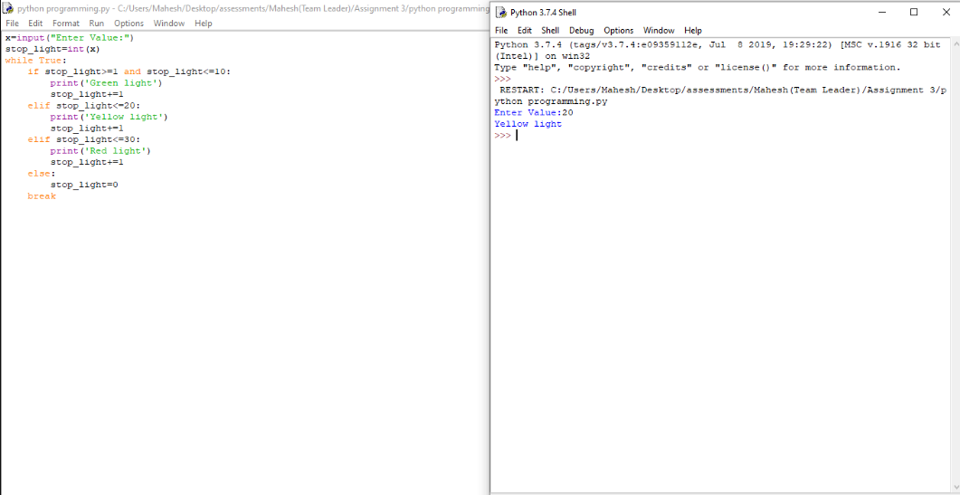

Slide 19
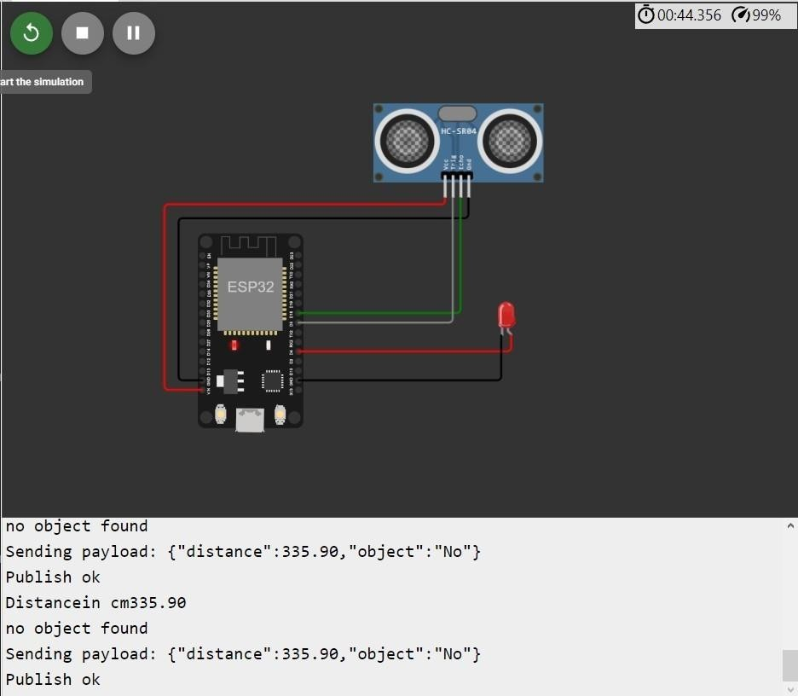

Slide 20
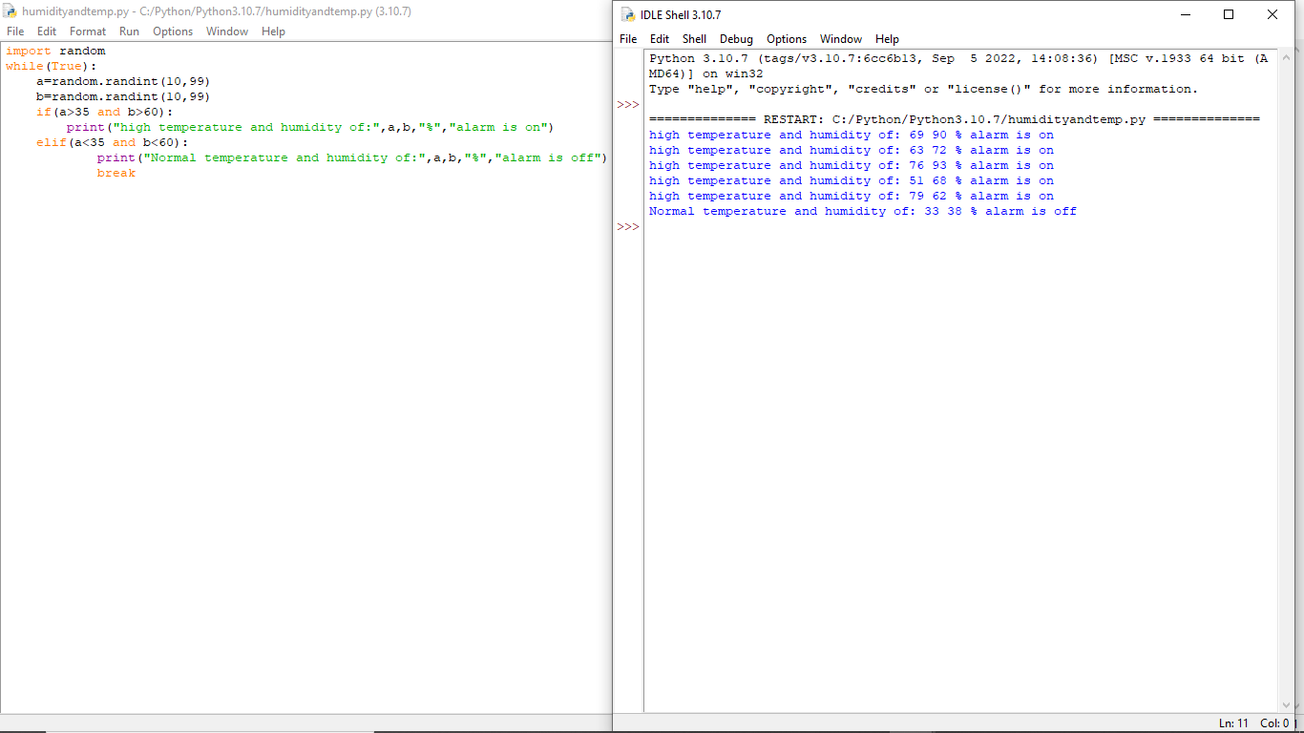

Slide 21
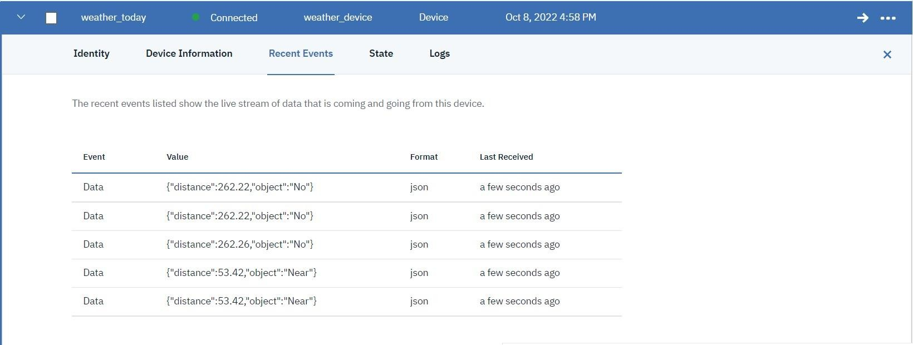

Slide 22
ADVANTAGES
Lower operating costs
Increased productivity and workplace safety
Better customer experiences
High efficient
User friendly
Easy to install

Slide 23
DISADVANTAGES
Determining the right process.
Feeling constrained.
Spending more than necessary.
Less efficient
Covers short area.

Slide 24
CONCLUSIONS
IOT based smart agriculture system can prove to be very helpful for farmers since over as well as less irrigation is not good for agriculture. Threshold values for climatic conditions like humidity, temperature, moisture can be fixed based on the environmental conditions of that particular region.
The system also senses the invasion of animals which is a primary reason for reduction in crops. This system generates irrigation schedule based on the sensed real time data from field and data from the weather repository. This system can recommend farmer whether or not, is there a need for irrigation. Continuous internet connectivity is required.

Slide 25
FUTURE SCOPES
Indian agriculture is diverse ranging from impoverished farm villages to developed farms utilizing agricultural technologies. Promoting application of modern information technology in agriculture will solve a series of problems facing by farmers. Lack of exact information and communication leads to the loss in production.
Our paper is designed to overcome these problems. This system provides an intelligent monitoring platform framework and system structure for facility agriculture ecosystem based on IOT.

Slide 26
REFERENCES:
[1] Sinung Suakanto, Ventje J. L. Engel, Maclaurin Hutagalung, Dina Angela, “Sensor networks data acquisition and task management for decision support of smart agriculture,” in 2016 International Conference on Information Technology Systems and Innovation (ICITSI) Bandung – Bali, pp. 24–27, Oct. 2016.
[2] Chetan Dwarkani M, Ganesh Ram R, Jagannathan S, R. Priyatharshini “Smart agriculture system using sensors for agricultural task automation,” in 2015 IEEE International Conference on Technological Innovations in ICT for Agriculture and Rural Development (TIAR 2015).
[3] Nikesh Gondchwar, R. S. Kawitkar, “IOT based smart agriculture,” International journal Of Advanced research in computer and Communication Engineering (IJARCCE), vol. 5, no. 6, Jun. 2016.
[4] Narayut Putjaika, Sasimanee Phusae, Anupong Chen-Im, Phond Phunchongharn and Khajonpong Akkarajit Sakul, “A control system in intelligent agriculture by using arduino technology,” in Fifth ICT International Student Project Conference(ICT-ISPC), 2016.
[5] Tejas Bangera, Akshar Chauhan, Harsh Dedhia, Ritesh Godambe, Manoj Mishra, “IOT based smart village,” International Journal of Engineering Trends and Technology (IJETT), vol. 32, no. 6, Feb. 2016, ISSN: 2231- 5381.

